Slide 1
Lecture 9
Combinational Automatic Test-Pattern Generation (ATPG) Basics
Algorithms and representations
Structural vs. functional test
Definitions
Search spaces
Completeness
Algebras
Types of Algorithms

Slide 2
Origins of Stuck-Faults
Eldred (1959) – First use of structural testing for the Honeywell Datamatic 1000 computer
Galey, Norby, Roth (1961) – First publication of stuck-at-0 and stuck-at-1 faults
Seshu & Freeman (1962) – Use of stuck-faults for parallel fault simulation
Poage (1963) – Theoretical analysis of stuck-at faults

Slide 3
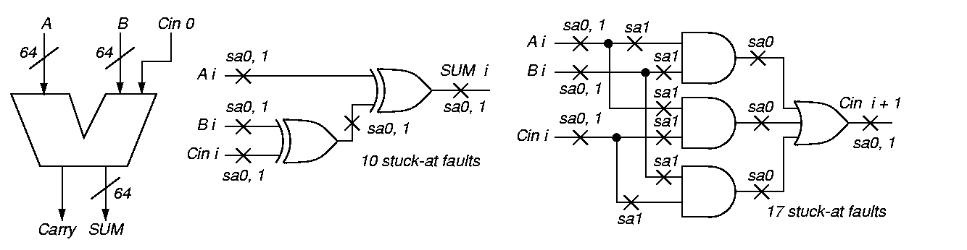
Functional vs. Structural ATPG

Slide 4
Carry Circuit

Slide 5
Functional vs. Structural
(Continued)
Functional ATPG – generate complete set of tests for circuit input-output combinations
  129 inputs, 65 outputs:
  2¹²⁹ = 680,564,733,841,876,926,926,749,
214,863,536,422,912 patterns
  Using 1 GHz ATE, would take 2.15 x 10²² years
Structural test:
  No redundant adder hardware, 64 bit slices
  Each with 27 faults (using fault equivalence)
  At most 64 x 27 = 1728 faults (tests)
  Takes 0.000001728 s on 1 GHz ATE
Designer gives small set of functional tests – augment with structural tests to boost coverage to 98⁺ %

Slide 6
Definition of Automatic Test-Pattern Generator
Operations on digital hardware:
  Inject fault into circuit modeled in computer
  Use various ways to activate and propagate fault effect through hardware to circuit output
  Output flips from expected to faulty signal
Electron-beam (E-beam) test observes internal signals – “picture” of nodes charged to 0 and 1 in different colors
  Too expensive
Scan design – add test hardware to all flip-flops to make them a giant shift register in test mode
  Can shift state in, scan state out
  Widely used – makes sequential test combinational
  Costs: 5 to 20% chip area, circuit delay, extra pin, longer test sequence

Slide 7
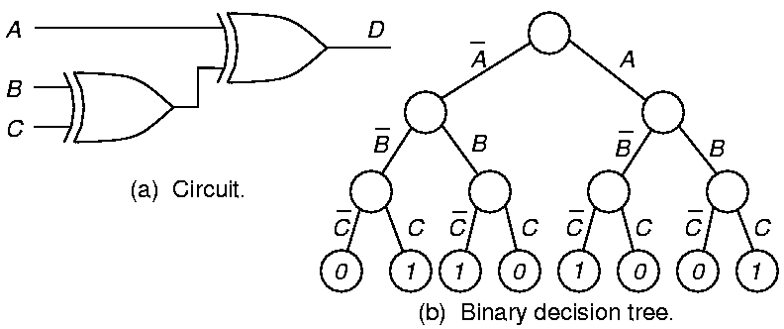
Circuit and Binary Decision Tree

Slide 8

Binary Decision Diagram
BDD – Follow path from source to sink node – product of literals along path gives Boolean value at sink
Rightmost path: A B C = 1
Problem: Size varies greatly
with variable order

Slide 9
Algorithm Completeness
Definition: Algorithm is complete if it ultimately can search entire binary decision tree, as needed, to generate a test
Untestable fault – no test for it even after entire tree searched
Combinational circuits only – untestable faults are redundant, showing the presence of unnecessary hardware

Slide 10
Algebras: Roth’s 5-Valued and Muth’s 9-Valued
Good
Machine
1
0
0
1
X
0
1
X
X
Failing
Machine
0
1
0
1
X
X
X
0
1
Symbol
D
D
0
1
X
G0
G1
F0
F1
Meaning
1/0
0/1
0/0
1/1
X/X
0/X
1/X
X/0
X/1
Roth’s
Algebra
Muth’s
Additions

Slide 11
Roth’s and Muth’s Higher-Order Algebras
Represent two machines, which are simulated simultaneously by a computer program:
  Good circuit machine (1st value)
  Bad circuit machine (2nd value)
Better to represent both in the algebra:
  Need only 1 pass of ATPG to solve both
  Good machine values that preclude bad machine values become obvious sooner & vice versa
Needed for complete ATPG:
  Combinational: Multi-path sensitization, Roth Algebra
  Sequential: Muth Algebra -- good and bad machines may have different initial values due to fault

Slide 12
Exhaustive Algorithm
For n-input circuit, generate all 2^{n} input patterns
Infeasible, unless circuit is partitioned into cones of logic, with 15 inputs
  Perform exhaustive ATPG for each cone
  Misses faults that require specific activation patterns for multiple cones to be tested

Slide 13
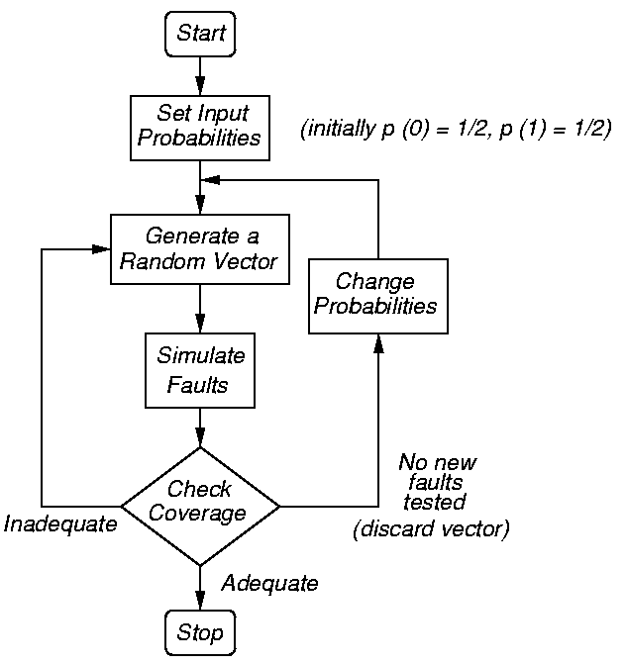
Random-Pattern Generation
Flow chart for method
Use to get tests for 60-80% of faults, then switch to D-algorithm or other ATPG for rest

Slide 14
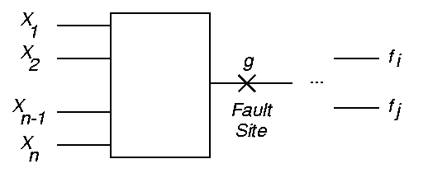
Boolean Difference Symbolic Method (Sellers et al.)
g = G (X₁, X₂, …, X_{n}) for the fault site
f_{j} = F_{j} (g, X₁, X₂, …, X_{n})
1 j m
X_{i} = 0 or 1 for 1 i n

Slide 15
Boolean Difference (Sellers, Hsiao, Bearnson)
Shannon’s Expansion Theorem:
F (X₁, X₂, …, X_{n}) = X₂ F (X₁, 1, …, X_{n}) + X₂ F (X₁, 0, …, X_{n})
Boolean Difference (partial derivative):
F_{j}
g
Fault Detection Requirements:
G (X₁, X₂, …, X_{n}) = 1
F_{j}
g
= F_{j} (1, X₁, X₂, …, X_{n}) F_{j} (0, X₁, …, X_{n})
= F_{j} (1, X₁, X₂, …, X_{n}) F_{j} (0, X₁, …, X_{n}) = 1

Slide 16
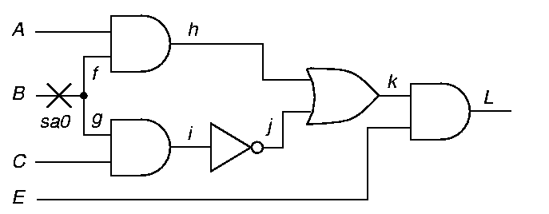
Path Sensitization Method Circuit Example
Fault Sensitization
Fault Propagation
Line Justification

Slide 17
Path Sensitization Method Circuit Example
Try path f – h – k – L blocked at j, since there is no way to justify the 1 on i
1
D
D
D
1
D
D
0
1
1

Slide 18
Path Sensitization Method Circuit Example
Try simultaneous paths f – h – k – L and
g – i – j – k – L blocked at k because D-frontier (chain of D or D) disappears
1
D
D
1
1
D
D
D
1

Slide 19
Path Sensitization Method Circuit Example
Final try: path g – i – j – k – L – test found!
0
0
D
1
D
D
D
D
1
1

Slide 20
Boolean Satisfiability
2SAT: x_{i} x_{j} + x_{j} x_{k} + x_{l} x_{m} … = 0
x_{p} x_{y} + x_{r} x_{s} + x_{t} x_{u} … = 0
3SAT: x_{i} x_{j} x_{k} + x_{j} x_{k} x_{l} + x_{l} x_{m} x_{n} … = 0
x_{p} x_{y} + x_{r} x_{s} x_{t} + x_{t} x_{u} x_{v} … = 0
.
.
.
.
.
.

Slide 21

Satisfiability Example for AND Gate
Σ a_{k} b_{k} c_{k} = 0 (non-tautology) or
Π (a_{k} + b_{k} + c_{k}) = 1 (satisfiability)
AND gate signal relationships: Cube:
  If a = 0, then z = 0 a z
  If b = 0, then z = 0 b z
  If z = 1, then a = 1 AND b = 1 z ab
  If a = 1 AND b = 1, then z = 1 a b z
Sum to get: a z + b z + a b z = 0
(third relationship is redundant with 1st two)

Slide 22
Pseudo-Boolean and Boolean False Functions
Pseudo-Boolean function: use ordinary + -- integer arithmetic operators
  Complementation of x represented by 1 – x
  F_{pseudo—Bool} = 2 z + a b – a z – b z – a b z = 0
Energy function representation: let any variable be in the range (0, 1) in pseudo-Boolean function
Boolean false expression:
f_{AND} (a, b, z) = z (ab) = a z + b z + a b z

Slide 23
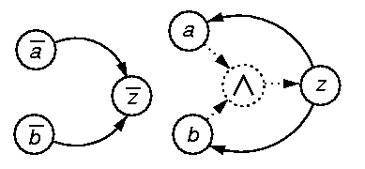
AND Gate Implication Graph
Really efficient
Each variable has 2 nodes, one for each literal
If … then clause represented by edge from if literal to then literal
Transform into transitive closure graph
  When node true, all reachable states are true
ANDing operator used for 3SAT relations

Slide 24
Computational Complexity
Ibarra and Sahni analysis – NP-Complete
(no polynomial expression found for compute time, presumed to be exponential)
Worst case:
no_pi inputs, 2 ^{no_pi} input combinations
no_ff flip-flops, 4 ^{no_ff} initial flip-flop states
(good machine 0 or 1 bad machine 0 or 1)
work to forward or reverse simulate n logic
gates α n
Complexity: O (n x 2 ^{no_pi} x 4 ^{no_ff})

Slide 25
History of Algorithm Speedups
Algorithm
D-ALG
PODEM
FAN
TOPS
SOCRATES
Waicukauski et al.
EST
TRAN
Recursive learning
Tafertshofer et al.
Est. speedup over D-ALG
(normalized to D-ALG time)
1
7
23
292
1574 ATPG System
2189 ATPG System
8765 ATPG System
3005 ATPG System
485
25057
Year
1966
1981
1983
1987
1988
1990
1991
1993
1995
1997

Slide 26
Analog Fault Modeling Impractical for Logic ATPG
Huge # of different possible analog faults in digital circuit
Exponential complexity of ATPG algorithm – a 20 flip-flop circuit can take days of computing
  Cannot afford to go to a lower-level model
Most test-pattern generators for digital circuits cannot even model at the transistor switch level (see textbook for 5 examples of switch-level ATPG)

